Slide 1



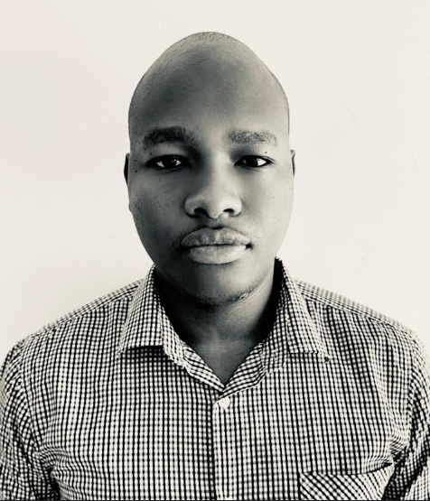

RAYNARD MAGEHEMA
Structural Engineer, P Eng. T
PhD Student – Civil Engineering.

Slide 2
Resume.
Equity and Merit
Scholarships
ERB Professional Engineering Charter
Chadwick Scholarships
2022
2023
2025
2019
2020
2021
2022
2023
2024
2025
BSc. Civil Engineering (First Class)
Ardhi University ,Tanzania
MSc. Structural Engineering (Distinction)
University of Manchester
PhD. Civil Engineering
University College London
EDUCATION
2015 - 2019
2022 - 2023
2025 - 2029
2019 - 2021
Selca Consult (T) Ltd: Civil Engineering Trainee
2021 – To Date
Design and Supervision of civil engineering projects.
Proposal preparations
Ardhi University, Tanzania: Assistant Lecturer
Teaching Civil Engineering Courses
Research Activities
Engineering Consultancy services
CAREER
2023 – To date
Selca Consult (T) Ltd: Structural Engineer
Design and supervision of structural engineering projects.
Training and mentoring graduate engineers.
Structural design and detailing
Proficiency in CAD Software
Soil and materials engineering design
Site management
Leadership
Catastrophe Risk Modelling
Programming with Python
Multidisciplinary Research
Pedagogic Skills.
Programming with R.
Academic Writing.
Numerical Modelling with
tools like ANSYS, ABAQUS
and Midas.
Programming with MATLAB
and LabVIEW.
SKILLS

Slide 3
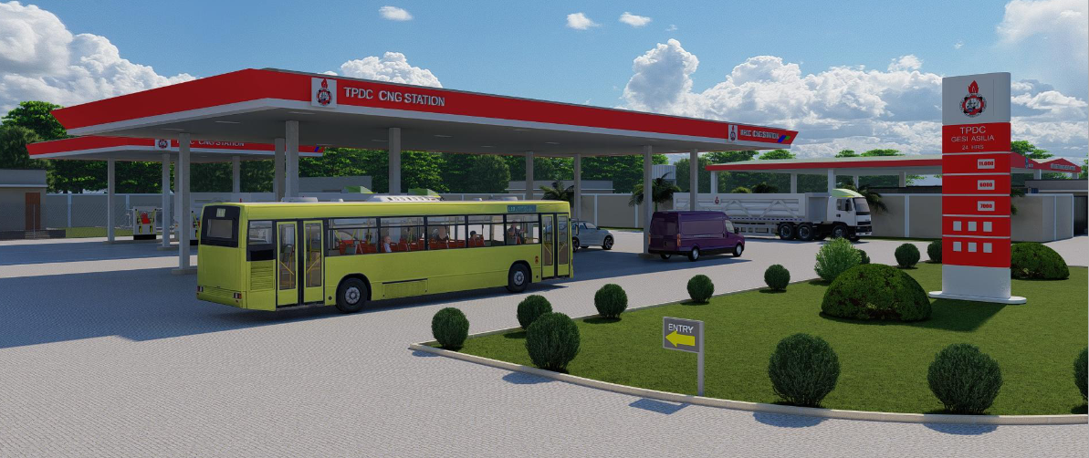
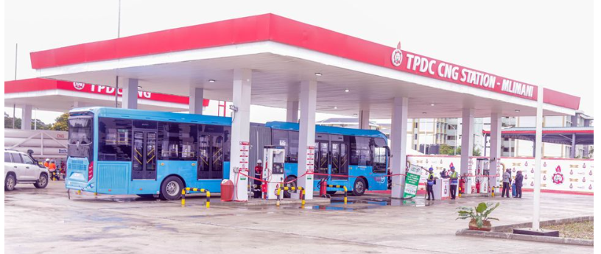
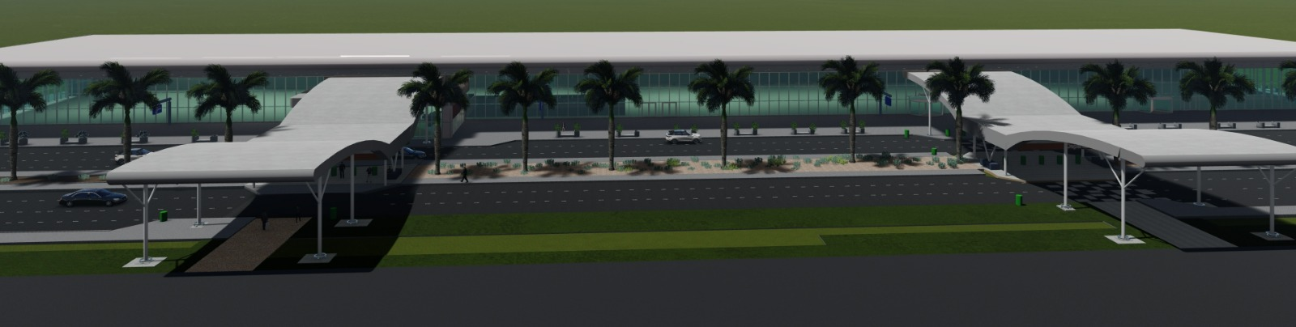
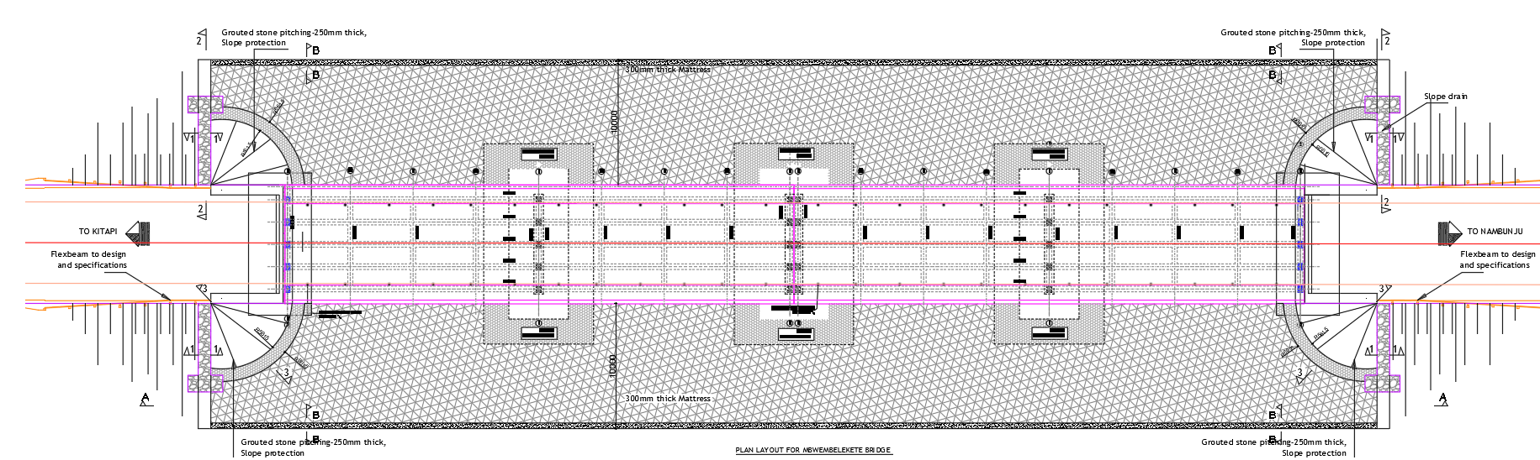
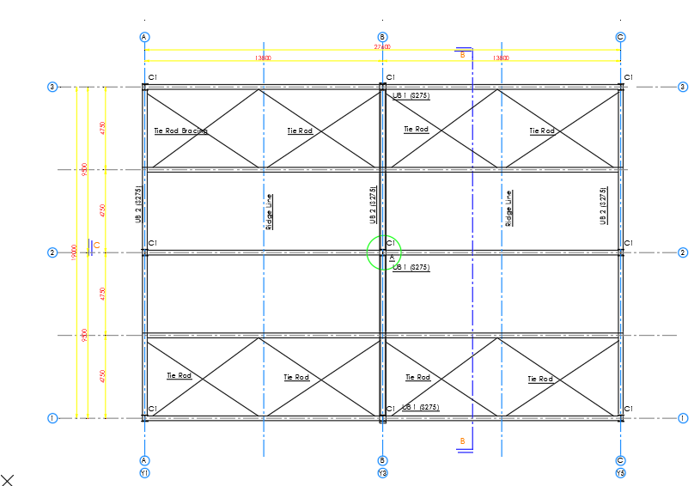
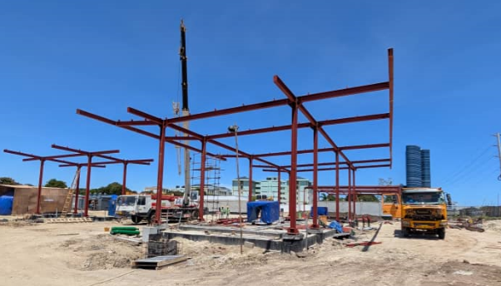
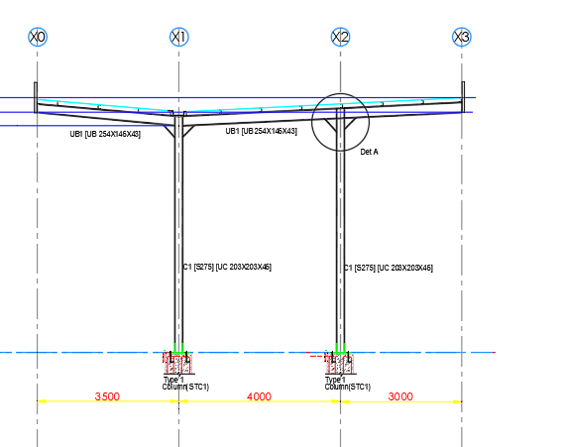
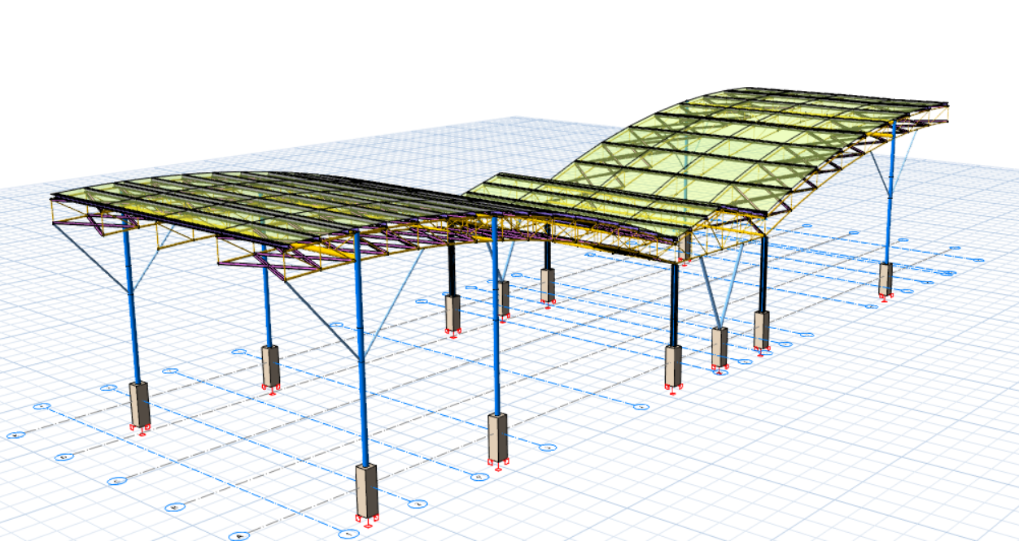
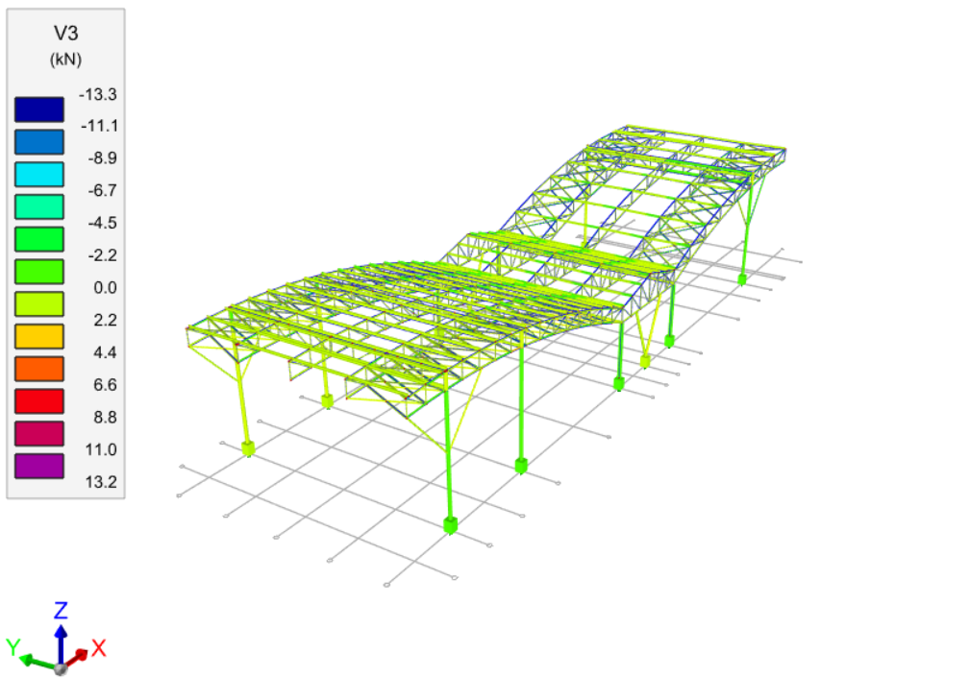
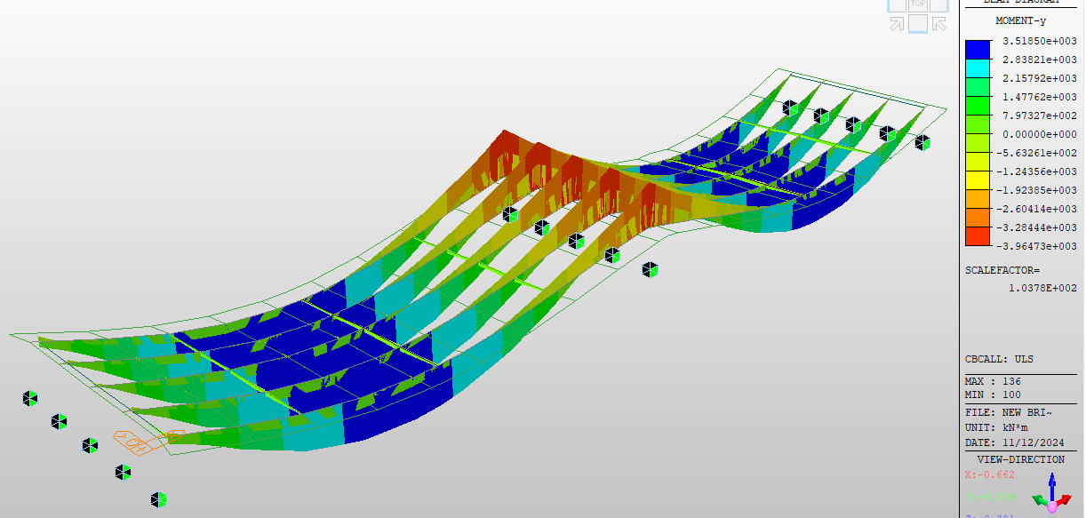
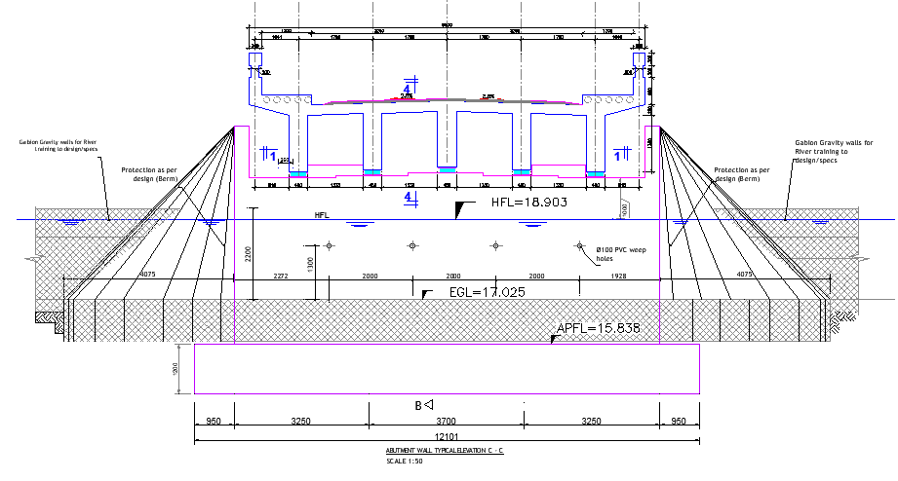
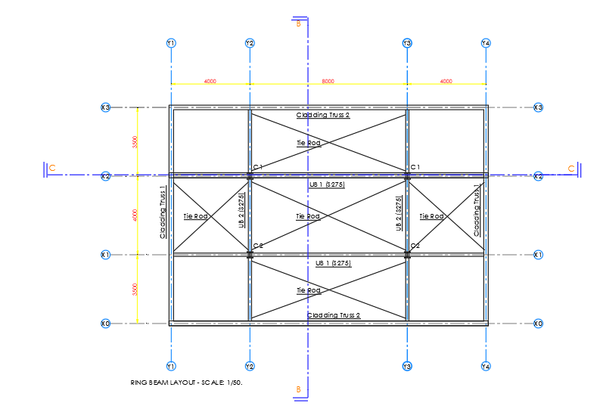
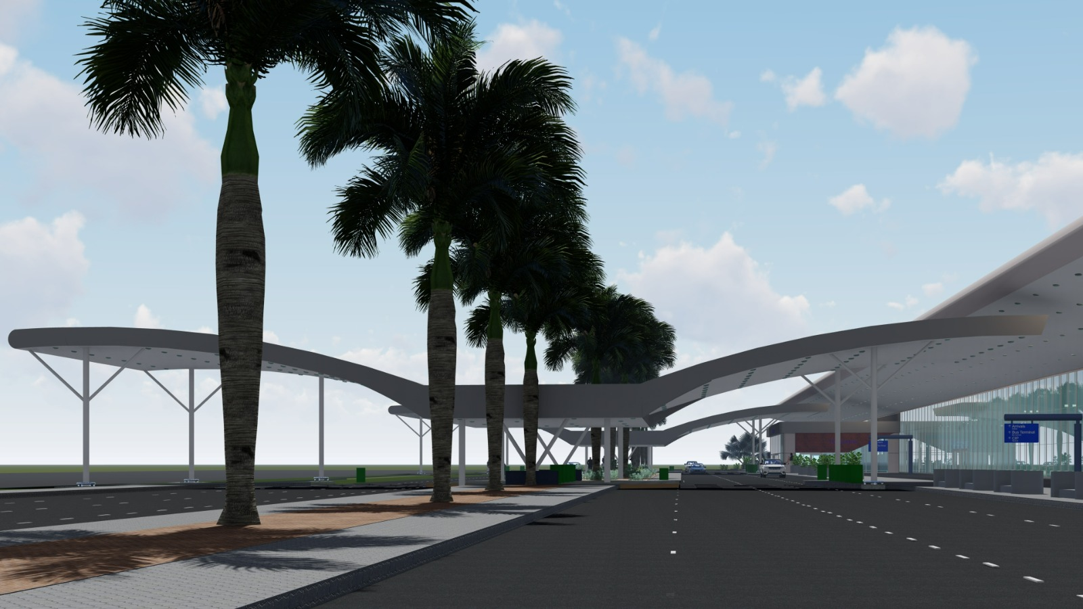
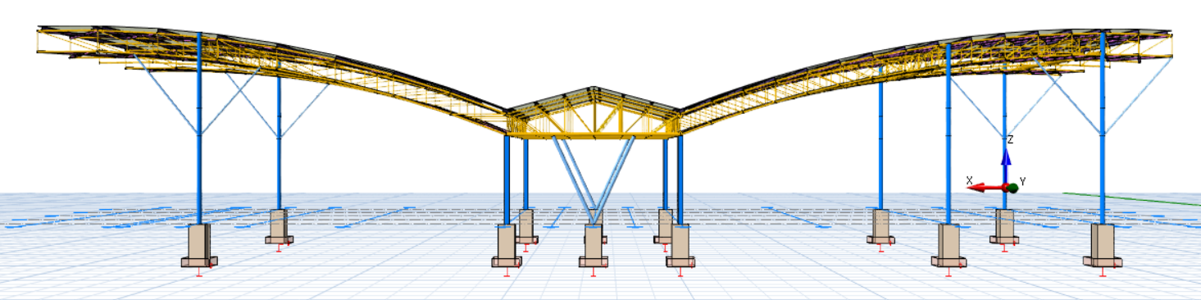
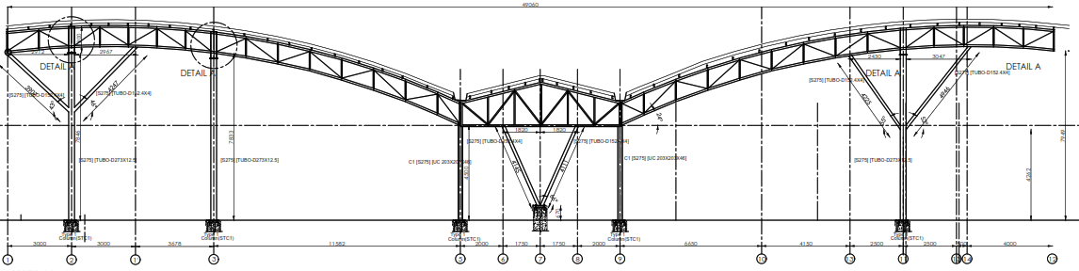
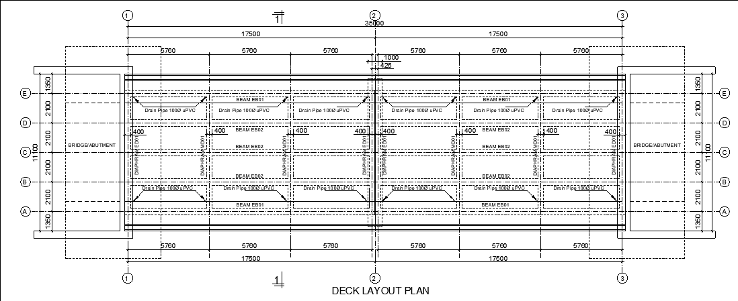
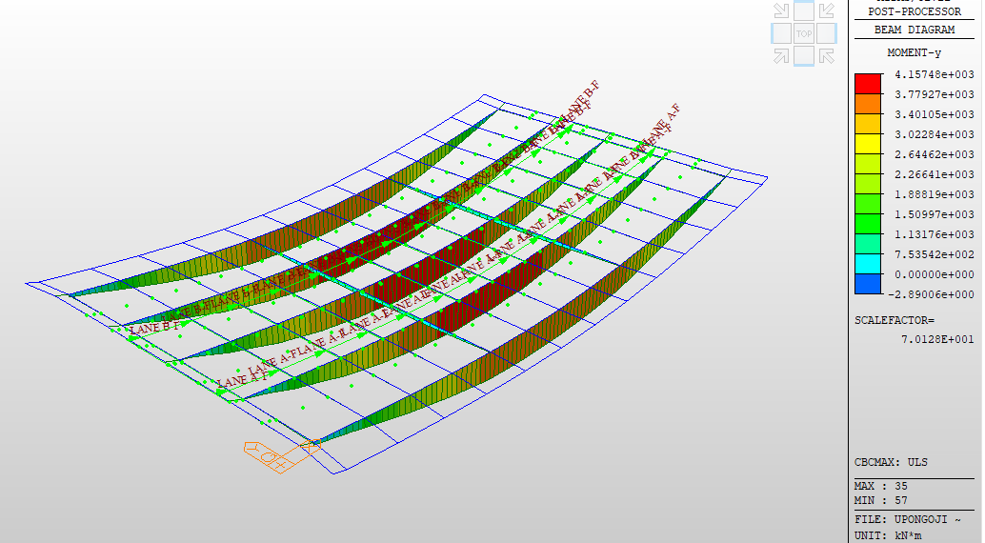
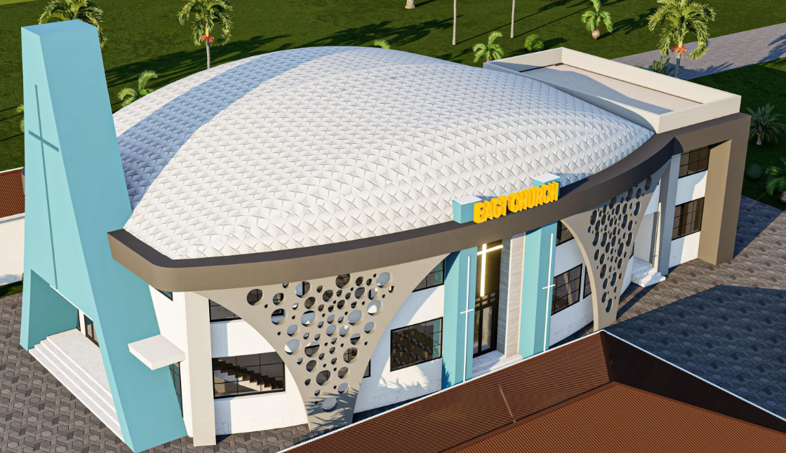
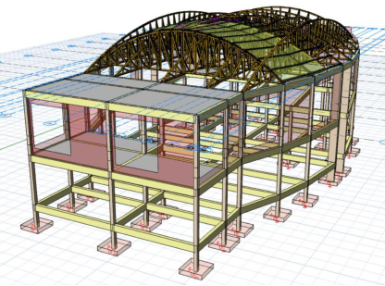
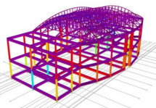
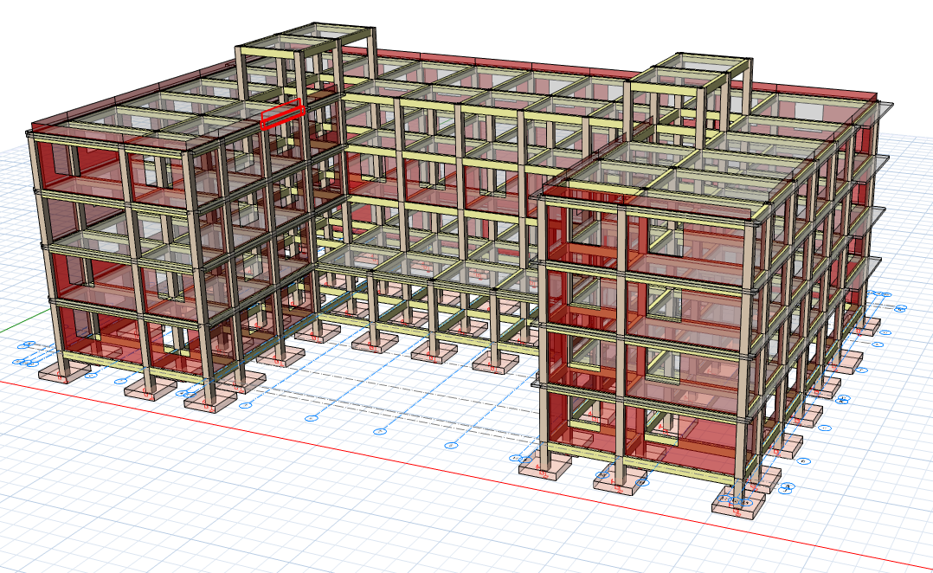
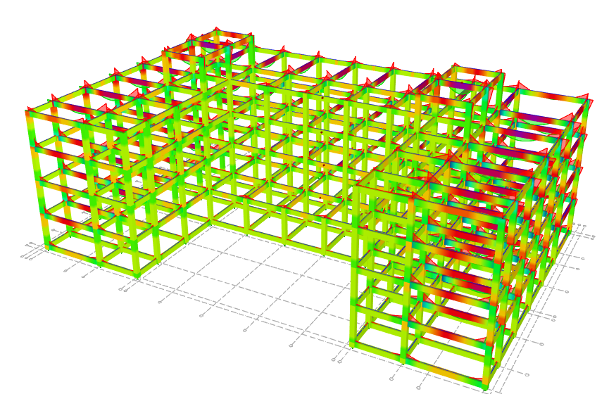
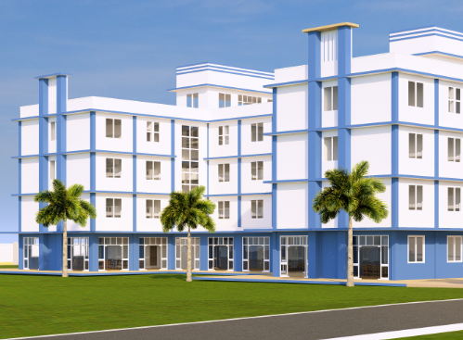
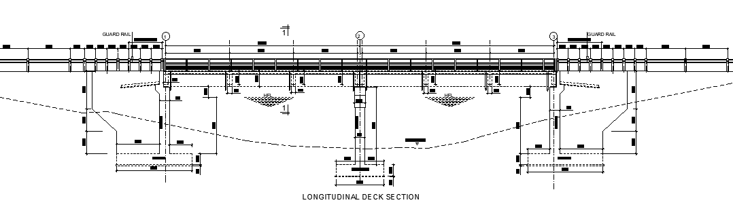
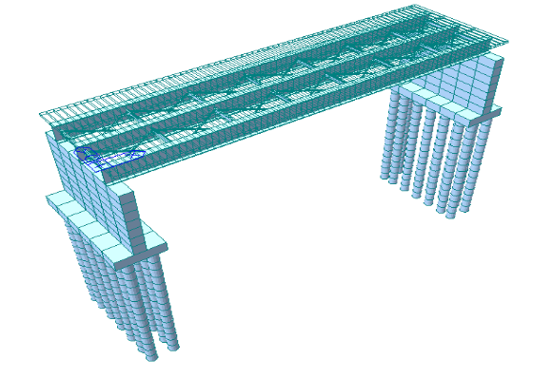
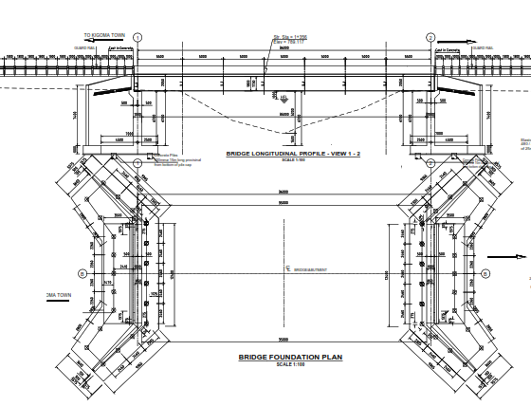
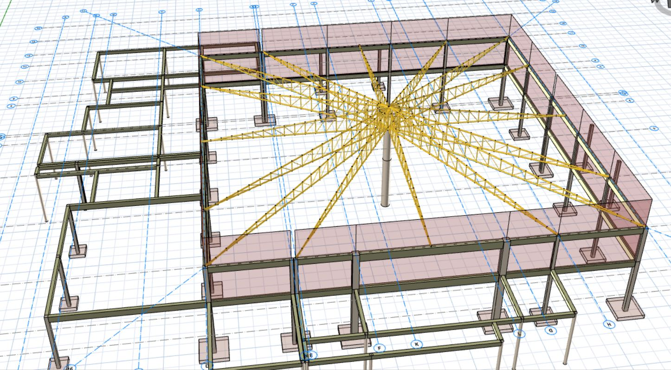
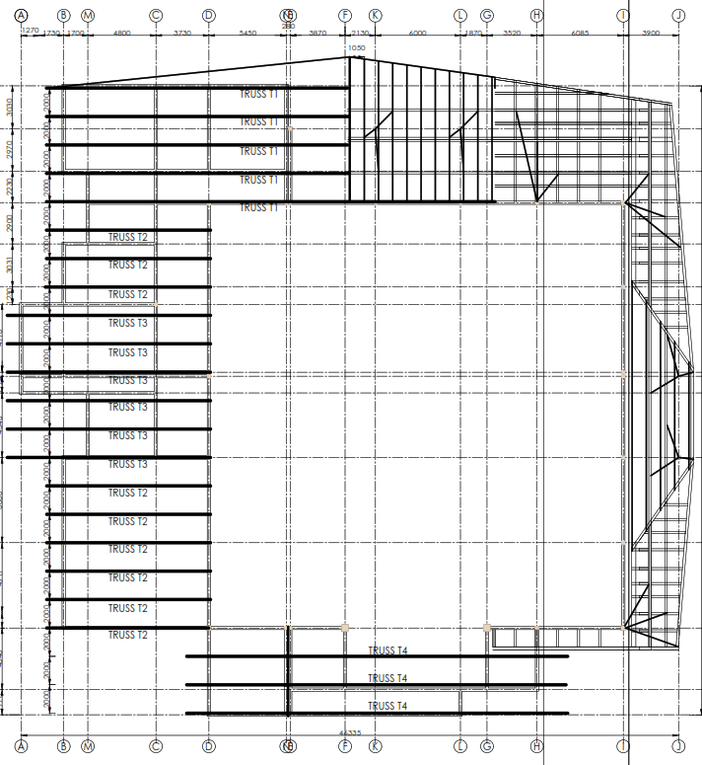
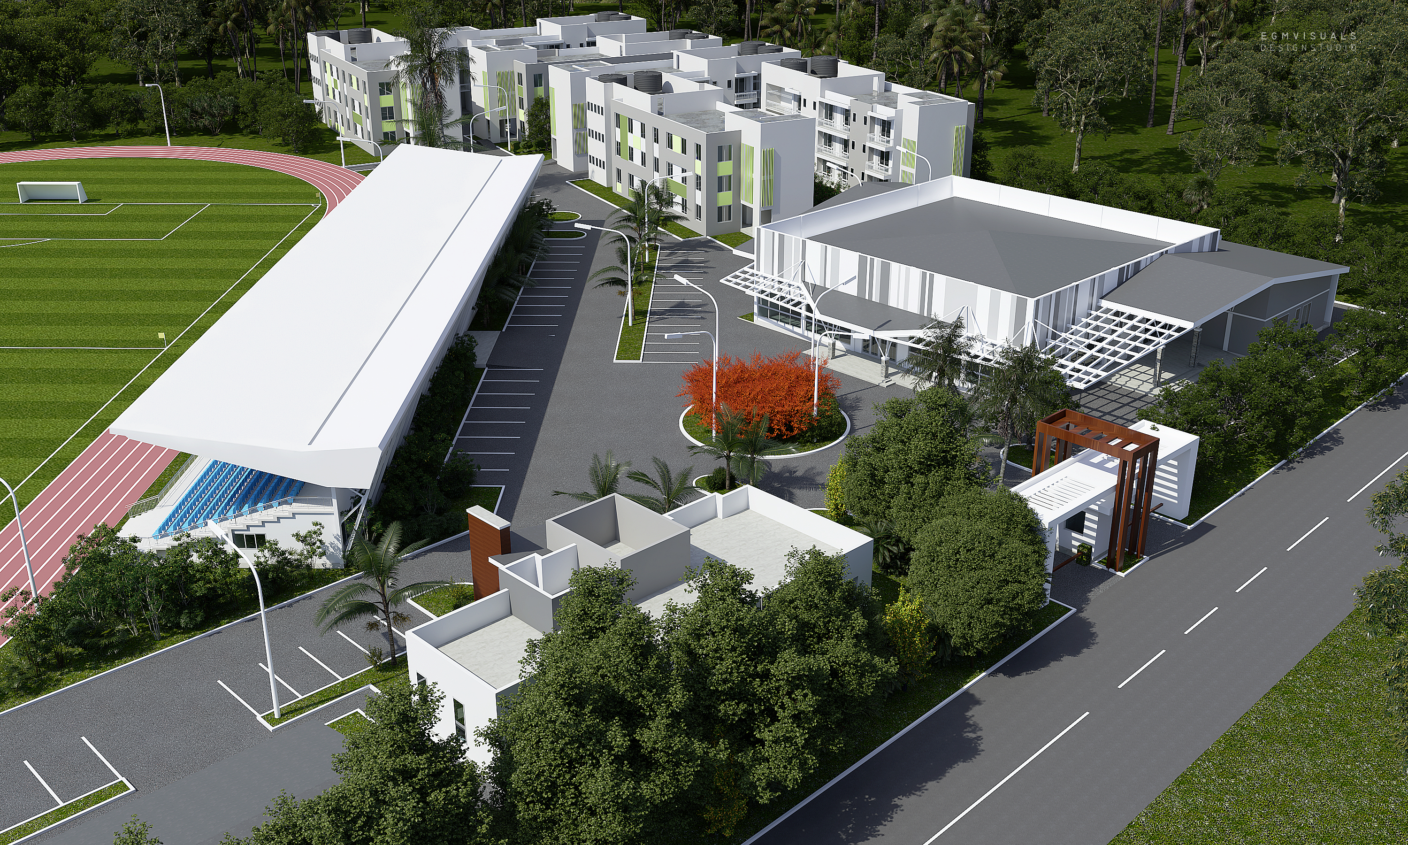
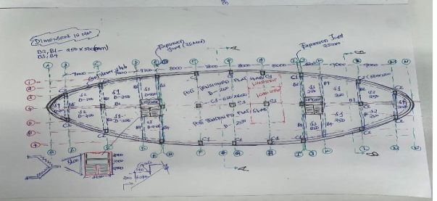
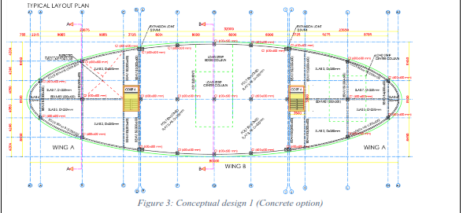
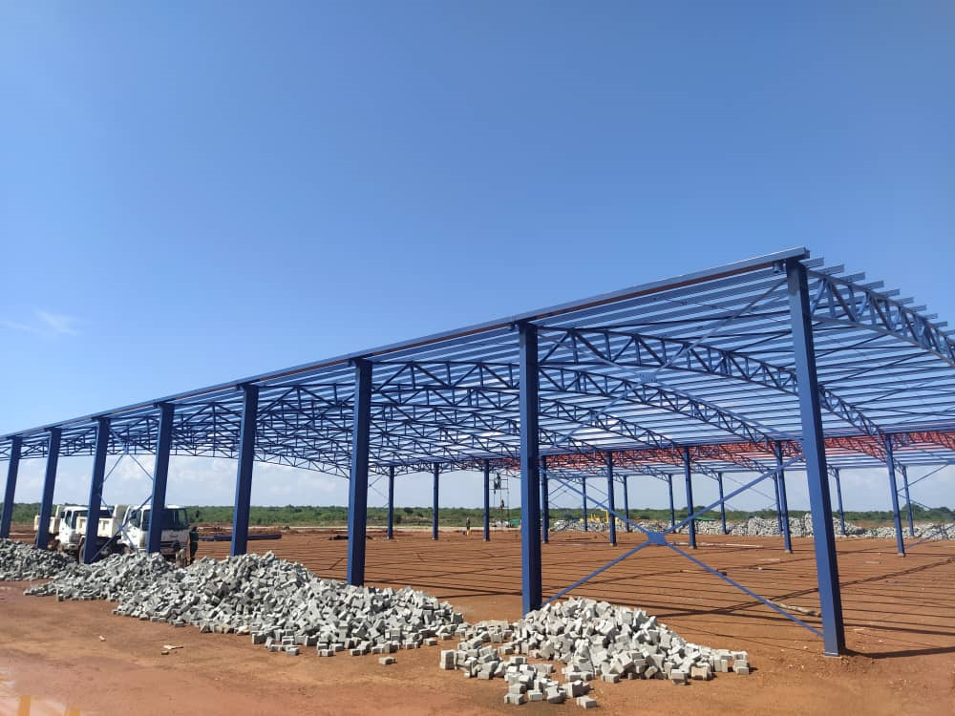
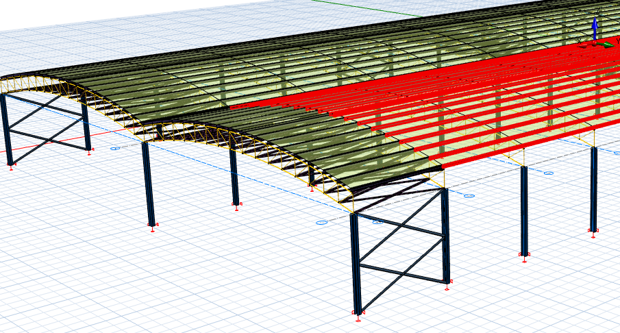
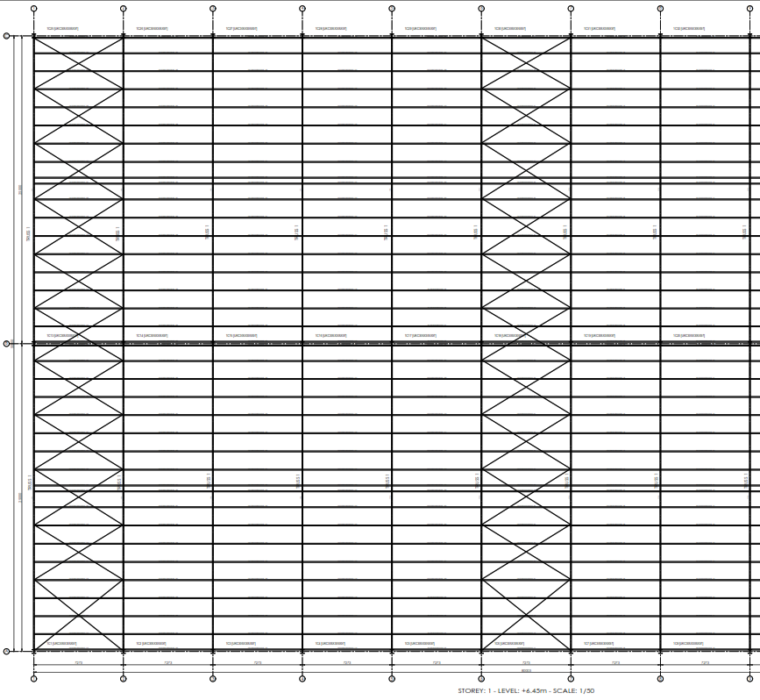
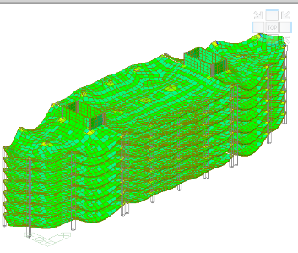
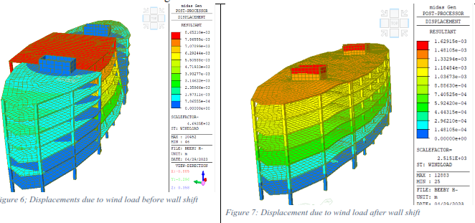
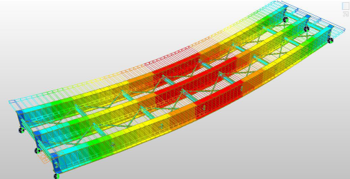
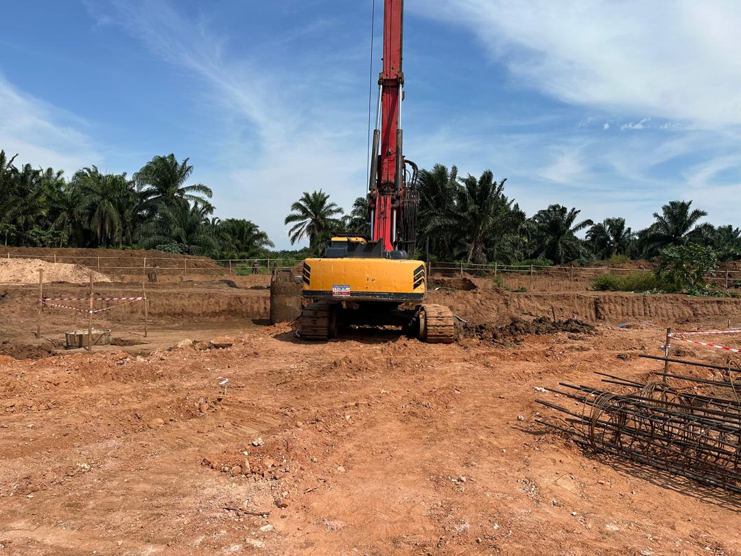
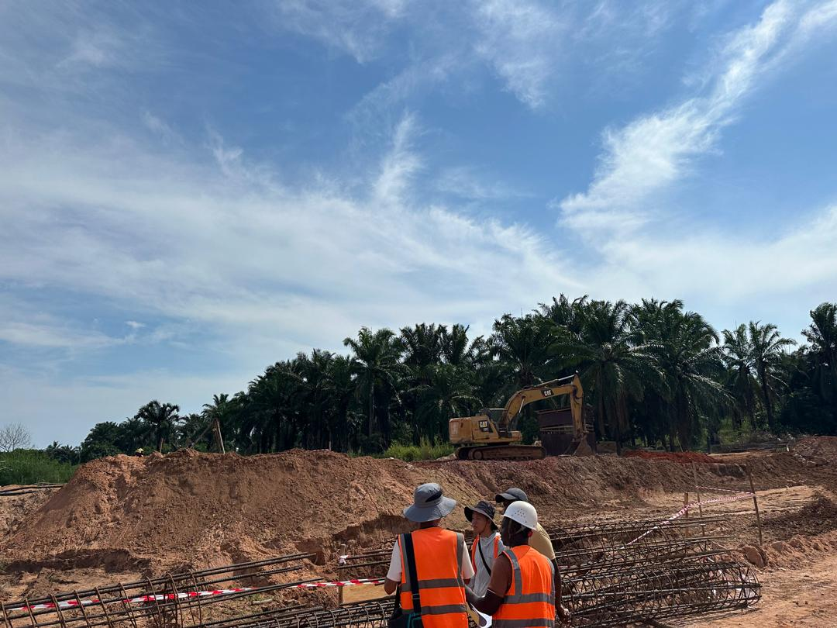
SOME STRUCTURAL ENGINEERING WORKS AND EXPERIENCE
STRUCTURAL DESIGN OF SHADES
STRUCTURAL DESIGN OF BRIDGES
STRUCTURAL DESIGN OF BUILDINGS

Slide 4
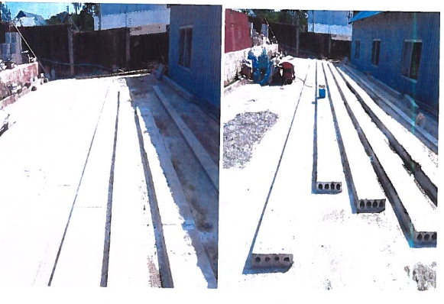
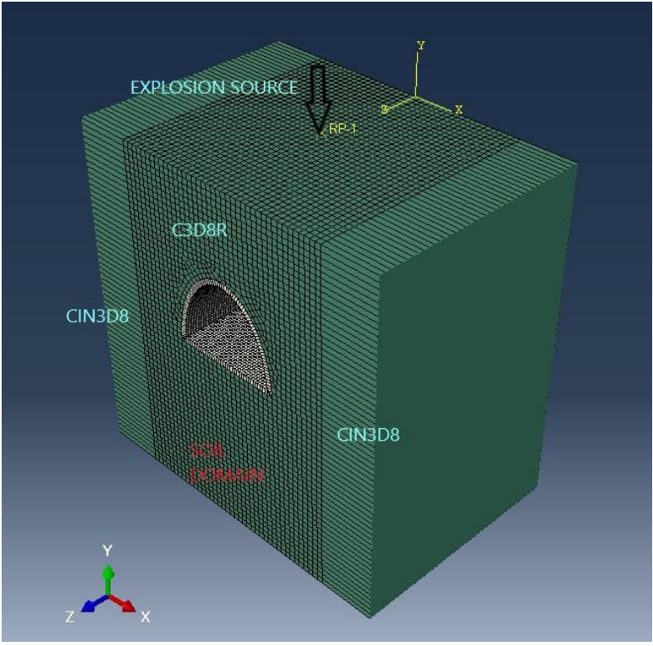
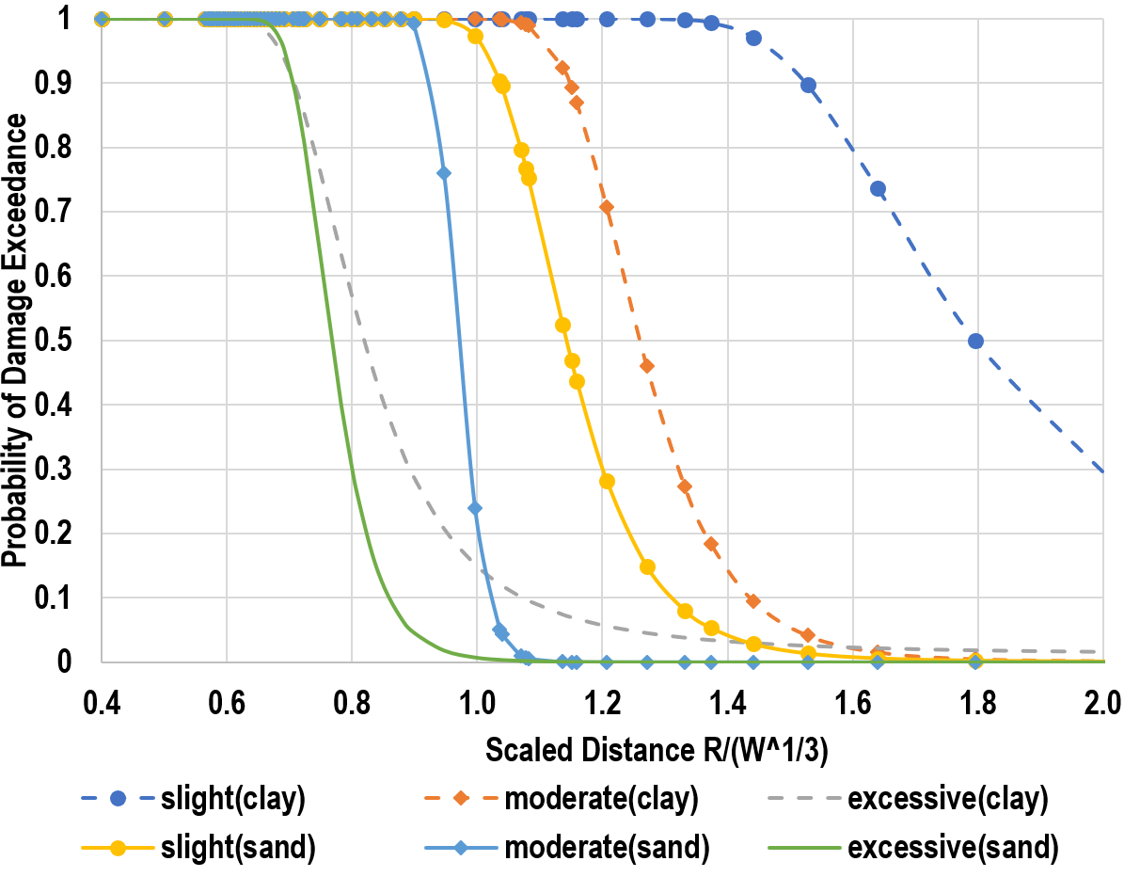
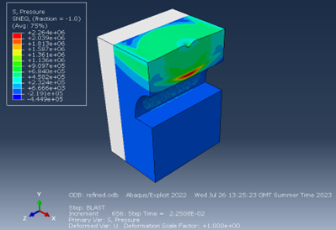
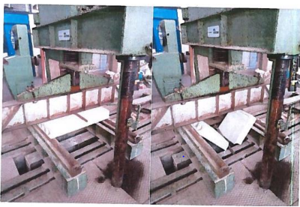
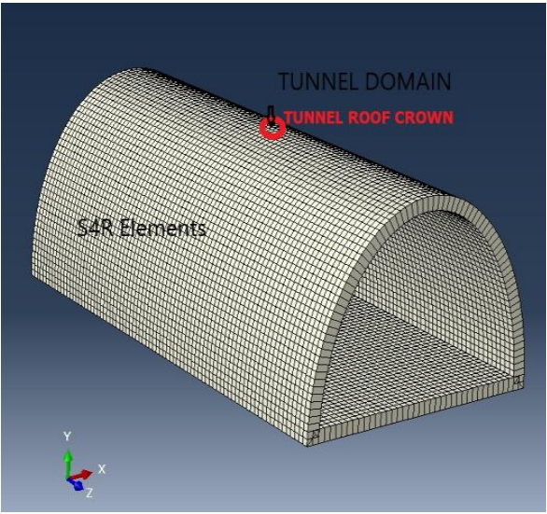
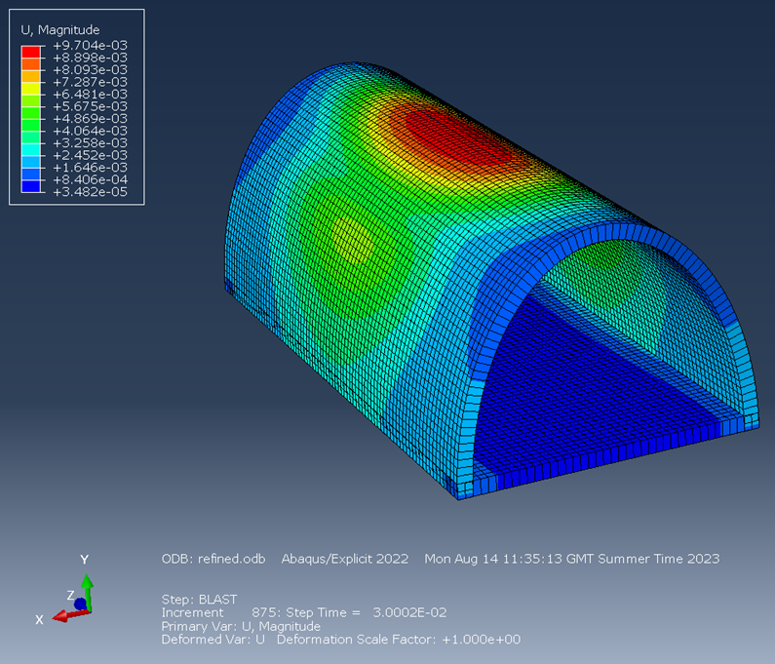
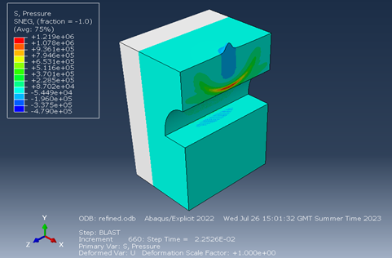
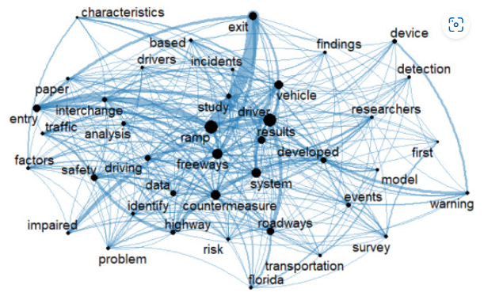
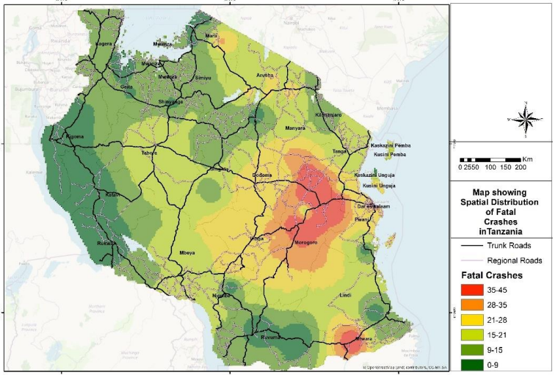
Research Endeavours and collaborations
Fragility of Tunnels to Blast Loads
Adaptation of Prestressed Hollow Core Slabs in Tanzania” A case of residential buildings
Leveraging text mining approach to explore research roadmap and future direction of wrong-way driving crash studies
Leveraging Social media data to understand severity of roadway crashes in Tanzania
Used social media data to map type of roadway crashes in Tanzania and understand the severity of these crashes.
Created text networks of different abstracts to map out wrong way driving crashes research time line.
Text Network of the 50 Topmost Topics in abstracts for 2011–2015 Period
Source: Kutela et al, 2019
Heat map of fatal crushes
Source: Kutela et al, 2022

